Slide 2
Using your Web Browser,
Open this URL:
Click on the workshop you’re attending, and find:
1
http://mlhlocal.host/lhd-resources
2
Setup Instructions
The Code Samples
A demo project
A Workshop FAQ
These Workshop Slides
More Learning Resources
Notes:
What to Say:
Tell attendees we are going to check them in for the event
Once attendees check in, they will receive an email with the items listed on the slide
Attendees must check-in to get credit for attending this event
What to Do:
Confirm that everyone has checked in by asking participants to give you a signal when they receive the email.

Slide 3

Our Mission is to Empower Hackers.
65,000+
HACKERS
12,000+
PROJECTS CREATED
400+
CITIES
We hope you learn something awesome today!
Find more resources: http://mlh.io/
Notes:
What to Say:
Major League Hacking (MLH) events are meant to bring hackers together so they can learn, build, and share.
Give participants a brief overview of Major League Hacking (MLH).
Tell participants they can learn more at http://mlh.io/
Example Talking Points:
TODO
Through Localhost MLH is rethinking technology education to reflect how hackers actually learn and how fast the industry moves.
Here’s some quick facts about MLH:
Each year, MLH supports over 65,000 hackers around the world at events they facilitate
Those students create more than 12,000 amazing projects together
MLH is a global organization that empowers hackers in more than 400 cities and growing every day

Slide 4

Our unique expression of social good
Capital One is dedicated to providing opportunities and resources that will enable more people to succeed.
Through our Future Edge program, we’re investing in and collaborating with leading educational and community organizations across the U.S.—to help more people succeed in the 21st century.
We’re empowering families through financial literacy and affordable housing, helping individuals bridge the digital skills gap and showing small businesses how to harness technology to grow and compete.

Slide 5
What will you learn today?
1
How to include and work with a Python library
2
How to debug your code
3
You'll also review material from the first two workshops!
Notes:
What to Say:
Explain to participants what they will learn today
Learning is a core part of being a hacker and today they are going to learn something new
What to Do:
Get participants excited about the experience.

Slide 6
Why does this matter?
1
Many artificial intelligence projects are on the web. You want to be able to share your cool work with others!
2
Learning how to use third party libraries is a skill you'll use in any programming language.
3
Once you learn one programing language, you can learn any.
Notes:
What to Say:
Explain to participants what they will learn today
Learning is a core part of being a hacker and today they are going to learn something new
What to Do:
Get participants excited about the experience.

Slide 7
What do you remember from last time?
Discuss for a few minutes with someone around you.
Notes:
What to Say:
Read the slide.

Slide 8
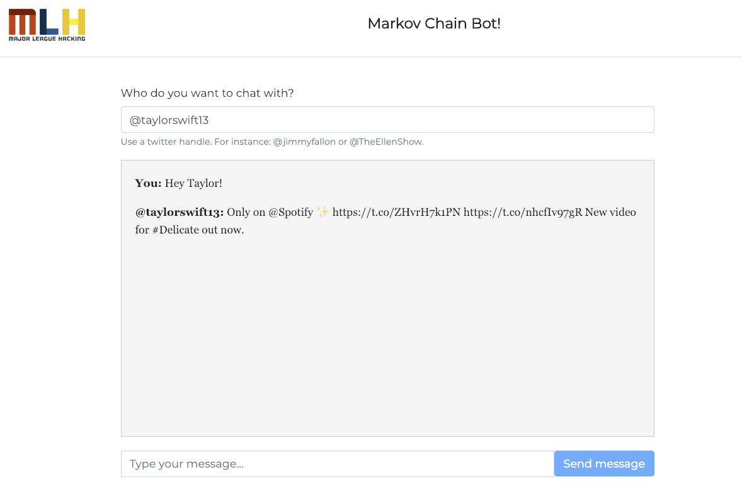
What are you going to build today?
Today you're going to incorporate the markovify library into your web app so that instead of responding with a Tweet, your app responds with a message that sounds like something your celebrity might say!
mlhlocal.host/glitch-markov

Slide 9
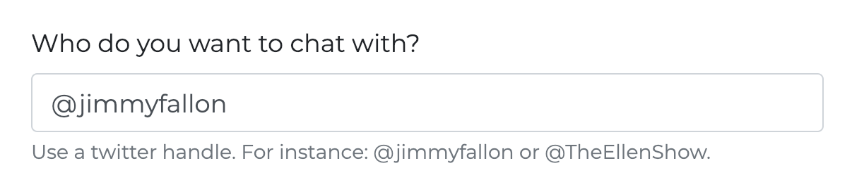
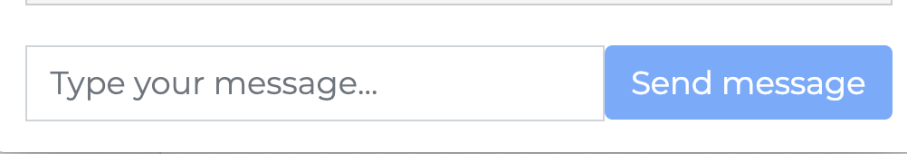


How does this work?
In the first box, the user enters a person's Twitter handle.
The user enters a message.
The Twitter user and message are sent to the app.
The app uses the Twitter API to request 10,000 tweets from that person.
The app uses a Python library called Flask to handle the requests and responses.
The app uses scraping and text formatting techniques to clean the tweets and pass them to a library called Markovify to generate responses!

Slide 10

How are you going to rebuild it?
These are the steps you'll need to take:
You'll make your own copy of the code on Glitch.
A lot of the code is the same from the second workshop, so in this workshop you'll focus only on the parts that are different.
You'll incorporate the Markovify library.
You'll debug some issues!
Then, you'll recap and take a quiz.

Slide 11
That may sound like a lot of steps. Part of coding/programming is learning how all the different tools work and how they work together. We know you can do it!
Notes:
What to Say:
Read the slide.

Slide 12

How are you going to build it?
There are lots of tools that can make coding easier!
We're still using Python, Glitch, and Flask.
Today, we're adding Markovify. Markovify is a Python library that generates Markov Chains. We'll learn more about Markov chains later. For now, you need to know that the Markov Chain is what generates the fake responses from your Twitter celebrity!

Slide 13


What's a Markov chain?
In artificial intelligence, there are many different models.
In math, you've seen different kinds of models.
Some graphs you've worked with are linear (straight lines), some are quadratic (parabolas), etc
A Markov chain is a complex model that is used to predict values in the future based on a given data set.
We use this model to generate fake responses in our app!
Key Terms
model: a mathematical way to predict future values
Notes:
Special thanks to https://medium.com/@Alexander_H/scraping-wikipedia-with-python-8000fc9c9e6c for inspiration!

Slide 14


A really simple example of a Markov Chain
Pretend there are only two possible types of weather - sunny or cloudy. That's it, two types.
Let's say that you want to be able to guess if the weather tomorrow will be sunny or cloudy.
You look back through weather reports for the last year and write down whether every day was sunny or cloudy. You do some math, and you learn that over the last year, if any day was cloudy, 25% of the time the next day was sunny and 75% of the time the next day was cloudy.
You can use this information to make a table of what you think weather would look like for several days:
Thanks to Devin Soni for this explanation!
Notes:
Special thanks to https://towardsdatascience.com/introduction-to-markov-chains-50da3645a50d for inspiration!

Slide 15


A really simple example of a Markov Chain
Let's test this out for ourselves!
These are each days after a cloudy day.
These are each days after a cloudy day.
This is actually the day after a sunny day!
Notes:
Special thanks to https://towardsdatascience.com/introduction-to-markov-chains-50da3645a50d for inspiration!

Slide 16
A really simple example of a Markov Chain
In total, there are 8 days that come after cloudy days. How many of those days are cloudy? How many are sunny?
These are each days after a cloudy day.
These are each days after a cloudy day.
This is actually the day after a sunny day!
Notes:
Special thanks to https://towardsdatascience.com/introduction-to-markov-chains-50da3645a50d for inspiration!

Slide 17
A really simple example of a Markov Chain
6 of the days after cloudy days are also cloudy.
2 of the days after cloudy days are sunny.
These are each days after a cloudy day.
These are each days after a cloudy day.
This is actually the day after a sunny day!
Notes:
Special thanks to https://towardsdatascience.com/introduction-to-markov-chains-50da3645a50d for inspiration!

Slide 18
A really simple example of a Markov Chain
2 sunny days / 8 days after cloudy days = 25%
6 cloud days / 8 days after cloud days = 75%
We did it correctly!
These are each days after a cloudy day.
These are each days after a cloudy day.
This is actually the day after a sunny day!
Notes:
Special thanks to https://towardsdatascience.com/introduction-to-markov-chains-50da3645a50d for inspiration!

Slide 19
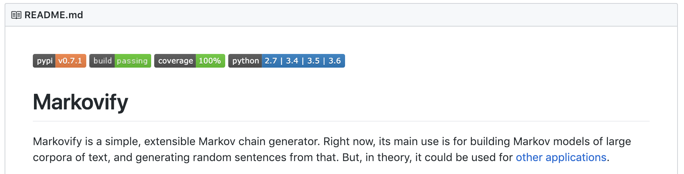
A really simple example of a Markov Chain
But! The weather is actually way more complicated than just cloudy or sunny, right? Imagine if we added partly cloudy, and rainy. Now you'd have four different types of weather to keep track of! Calculating that by hand would be a nightmare!
Instead of doing this by hand, we'll use a Python library called Markovify!
Notes:
Special thanks to https://towardsdatascience.com/introduction-to-markov-chains-50da3645a50d for inspiration!

Slide 20
In our example, we were using Markov Chains to analyze weather (sunny or cloudy). You can use this for ANYTHING you can count. We'll use Markov to predict what words come after other words based on a person's Tweets!
Notes:
What to Say:
Read the slide.

Slide 21
What's Markovify?
Markovify is a Python library written and maintained by GitHub user jsvine.
Markovify can be added to any Python project.
Markovify takes a large input of text and runs the same sort of calculations on it that we learned in the last few slides (but it can do it for thousands of different options rather than just cloudy and sunny).
Markovify calculates how often one word appears after the next in the text input. Simply put, it makes a list of each word in the text. Then, it makes a list of what words come next, and how many times each pattern repeats (like we did with the clouds).
It uses those percentages to generate fake sentences based on how likely one word is to follow another.
It's not perfect, and that's why our app has some strange output sometimes!
Notes:
Special thanks to https://medium.com/@Alexander_H/scraping-wikipedia-with-python-8000fc9c9e6c for inspiration!

Slide 22

Some things to keep in mind
Writing code is tricky. Pay attention to the following best practices
The majority of the time, when something isn't working with your code, it's as simple as a typo. Make sure that you've typed everything correctly before moving on to other debugging techniques.
Glitch has a really cool rewind feature. If your code was working before, and it's not working now, use the rewind feature to back up.
It's okay to make mistakes! You're learning something new, and that's really tricky.
Notes:
Special thanks to https://medium.com/@Alexander_H/scraping-wikipedia-with-python-8000fc9c9e6c for inspiration!

Slide 23
Let's get started!
Notes:
What to Say:
Read the slide.

Slide 25



What Python Skills Did We Learn Last Time?
Regular expressions – a programming concept used to work with text
Imports – using data or functions from other sources (like libraries or other files in our project)

Slide 26
The best way to learn to code is to CODE, not to read about it, so let's dive in!
Notes:
What to Say:
Read the slide.

Slide 28
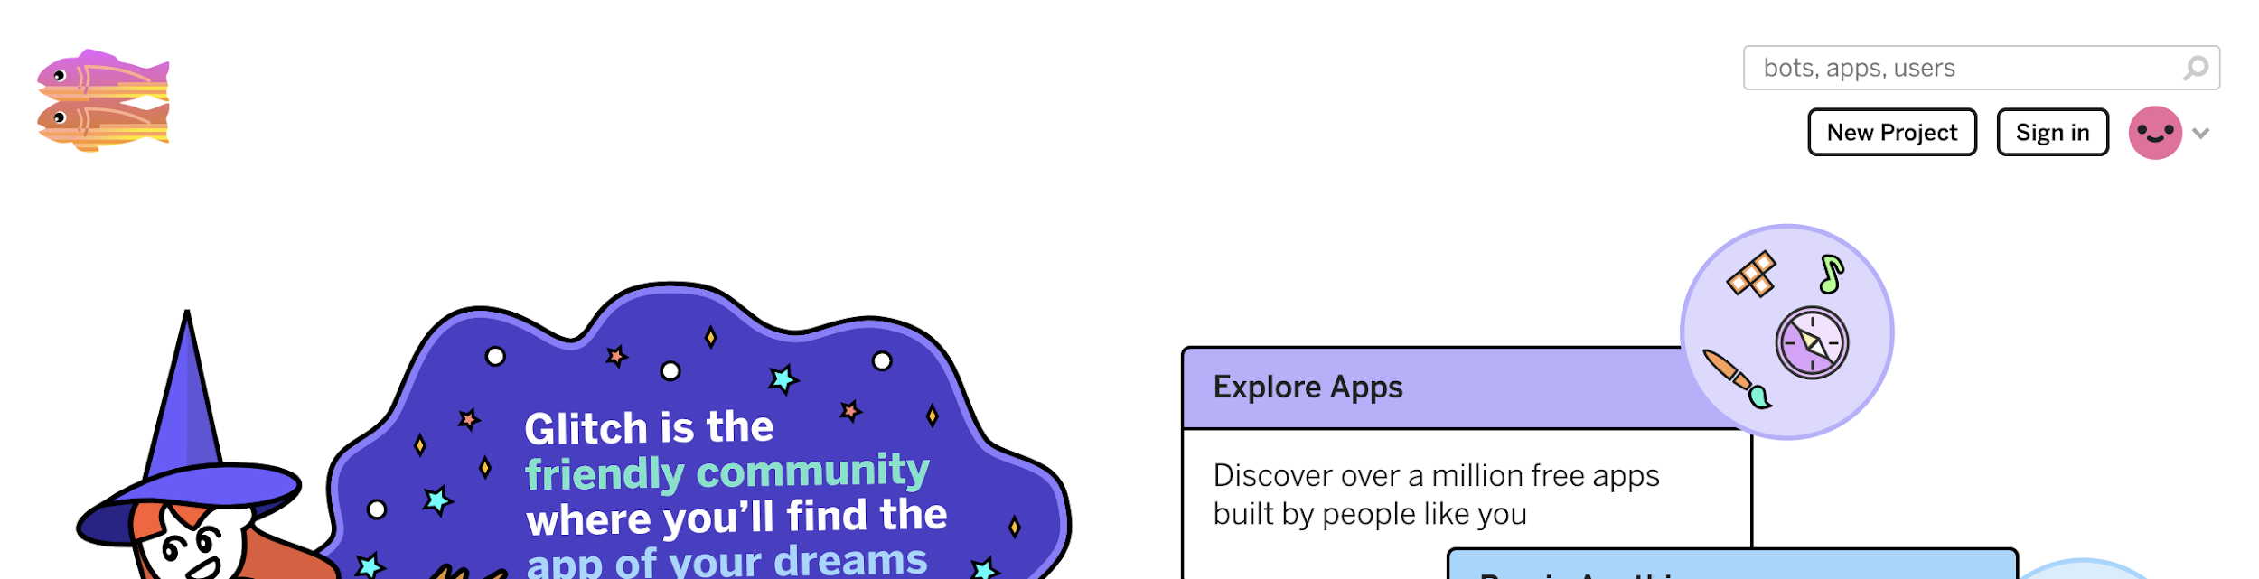
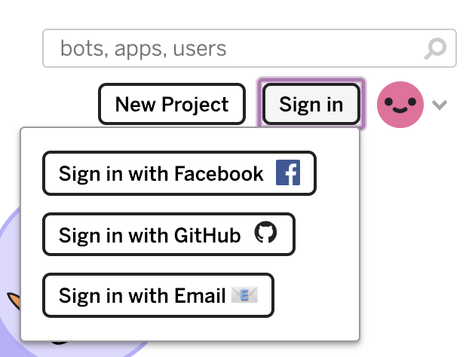
Glitch
http://mlhlocal.host/glitch
Navigate to the URL above.
Click Sign in. Choose how you want to log in.

Slide 29
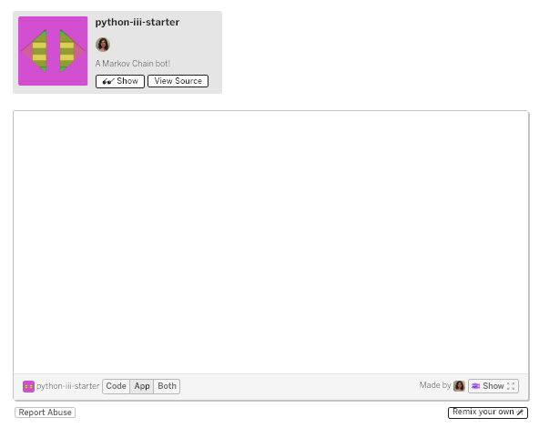
Get the code!
mlhlocal.host/glitch-python-iii
Go to the URL above. Click Remix Your Own

Slide 30
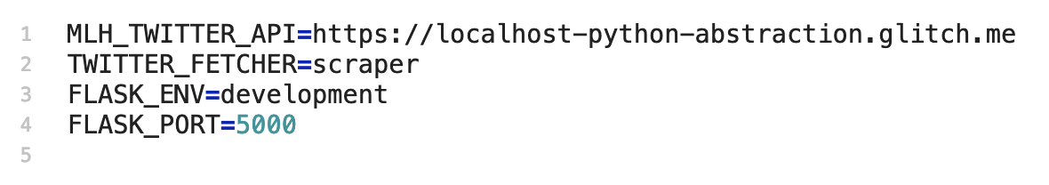
Get the code!
Add the the following code to .env file

Slide 31
In the last workshop, you used Twitter scraping and data cleaning to send a single Tweet back to the user.
But that's not very interesting! Let's do something cooler in this workshop.
Notes:
What to Say:
Read the slide.

Slide 32
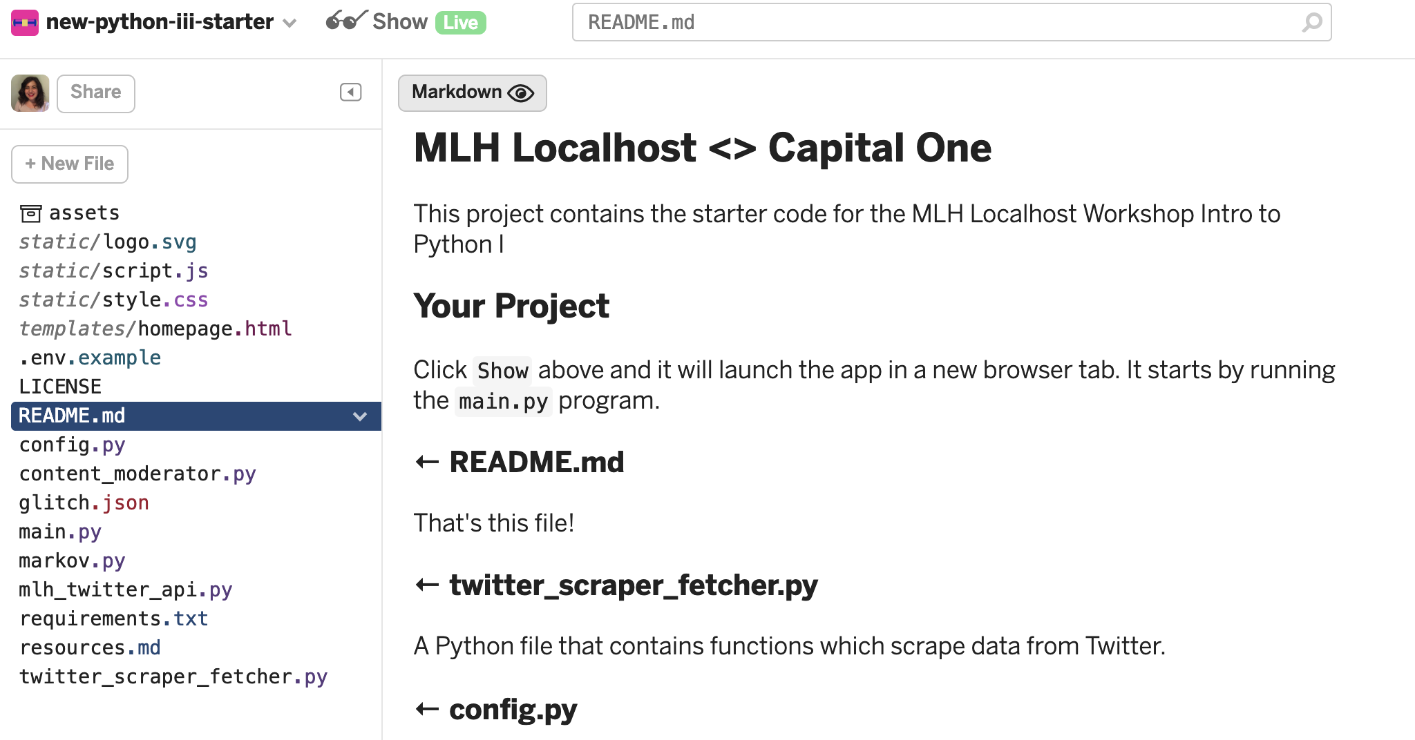
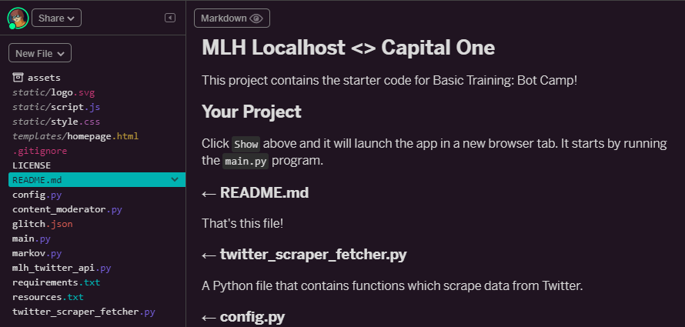
Let's explore the files

Slide 33
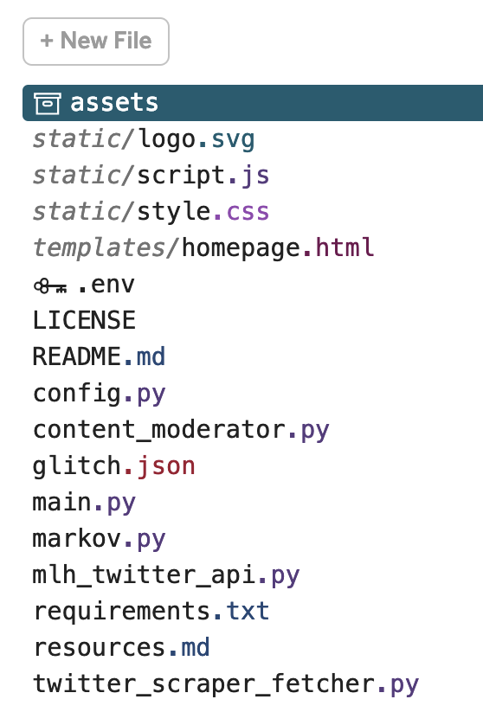
Code Review
These are the files we’ll be working with today:
mlh_twitter_api.py: This is a file that will allow us to use the Twitter API to return way more Tweets than we've returned in the past. We'll learn why this matters!
markov.py: This file is where we'll write the code to use the Markovify library to create bot responses!

Slide 35
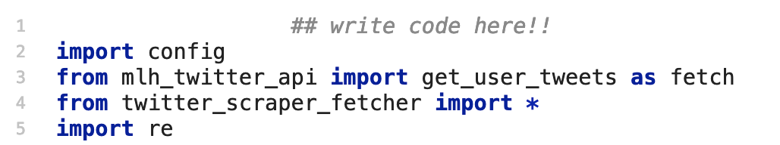
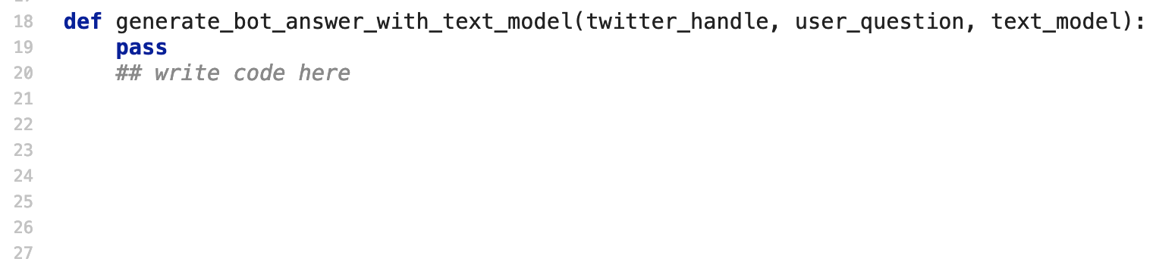
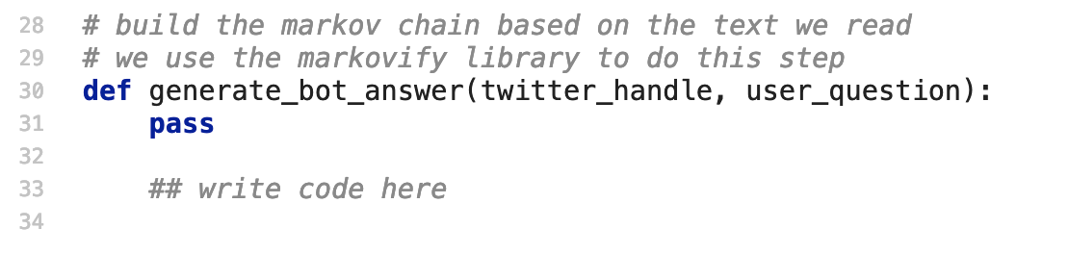
Let's write some code!
Open markov.py. There are three places in this file where you'll need to write some code. Let's identify them now!
You'll write one line of code on Line 1. You'll write this function. And this one too!

Slide 36
Write code: markov.py
On line 1, we need to allow our file to use the markovify library. How do you think you'd add that code?
1
2
3
4
5
6
## write code here
import config
from mlh_twitter_api import get_user_tweets as fetch
from twitter_scraper_fetcher import *
import re

Slide 37
Let's write some code!
Did you do it correctly?
1
2
3
4
5
6
import markovify
import config
from mlh_twitter_api import get_user_tweets as fetch
from twitter_scraper_fetcher import *
import re

Slide 38
Are you ready for the hardest part of this whole series?
We know you can do it!
Notes:
What to Say:
Read the slide.

Slide 39
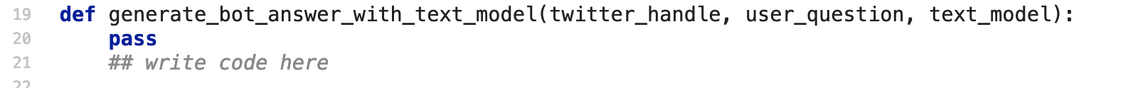
Let's write some code!
On Line 14, we have started the definition of a function called generate_bot_answer_with_text_model(). This function needs to do several things:
Create a variable called bot_answer and set its value to None.
Split the user_question input into a list of words.
Retrieve one word from that list.
Pass that word into the make_sentence_with_start() function from Markovify, call that function on the text_model input, and save the result to bot_answer.
Return bot_answer.

Slide 40
Let's write some code!
14
15
16
17
18
19
20
def generate_bot_answer_with_text_model(...):
bot_answer = None
On Line 15, start by creating the bot_answer variable and set its value to None and delete the keyword pass

Slide 41
Let's write some code!
14
15
16
17
18
19
20
def generate_bot_answer_with_text_model(...):
bot_answer = None
word_list = user_question.split(' ')
On Line 17, split the user_question string into a list using the .split() method. You can put ' ' inside .split(). Make sure there is a space between the quotation marks. Save the output to a variable called word_list.

Slide 42
Let's write some code!
14
15
16
17
18
19
20
def generate_bot_answer_with_text_model(...):
bot_answer = None
word_list = user_question.split(' ')
random_word = random.choice(word_list)
On Line 18, create a variable called random_word. Set it equal to a random word from the word list, using the random.choice() method.

Slide 43
Let's write some code!
14
15
16
17
18
19
20
def generate_bot_answer_with_text_model(...):
bot_answer = None
word_list = user_question.split(' ')
random_word = random.choice(word_list)
bot_answer = text_model.make_sentence_with_start()
On Line 19, call the make_sentence_with_start() method on text_model. Save the output to bot_answer. .

Slide 44
Let's write some code!
14
15
16
17
18
19
20
21
def generate_bot_answer_with_text_model(...):
bot_answer = None
word_list = user_question.split(' ')
random_word = random.choice(word_list)
bot_answer = text_model.make_sentence_with_start(random_word, strict=False)
return bot_answer
Still on Line 19, we're going to add 2 parameters (inputs) to make_sentence_with_start(): random_word, strict=False
On Line 21, return bot_answer.

Slide 45
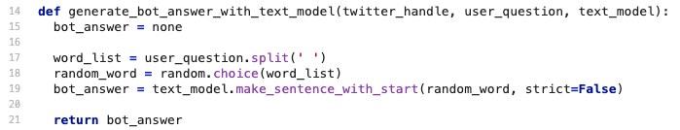
Let's write some code!
Woah! What did we just do?
We used a function from Markovify called make_sentence_with_start() and called it on text_model.
text_model is the output of feeding our celebrity's Tweets into Markovify.
Now, we're asking Markovify to create a sentence, and we want it to base that sentence on a random word from the user's question.

Slide 46
Let's try it out!
Notes:
What to Say:
Read the slide.

Slide 47
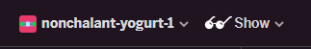
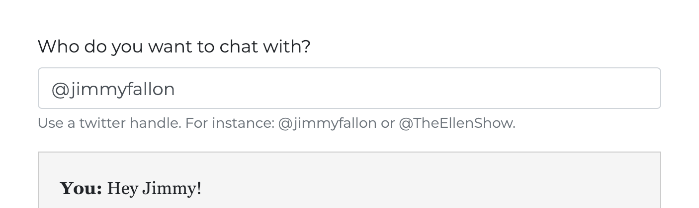
Let's Try it Out!
In the top left hand corner of your browser, click Show.
Try it in the browser tab that opens!

Slide 48
Woah! What went wrong?
Notes:
What to Say:
Read the slide.

Slide 49
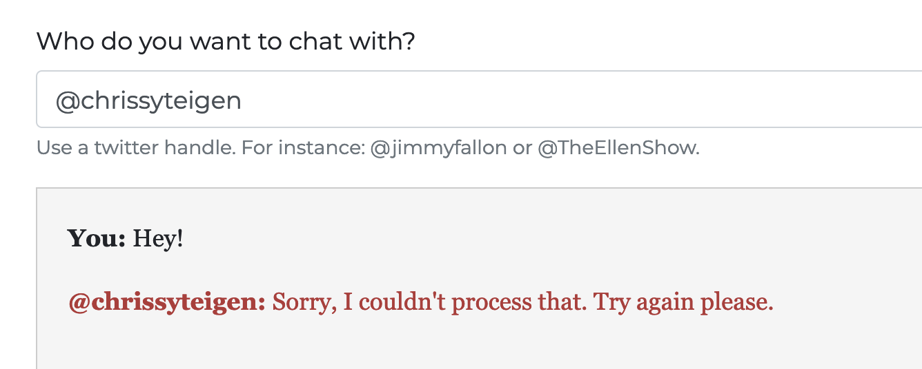
Woah, what went wrong?
Did you get an error?
Let's investigate!

Slide 50
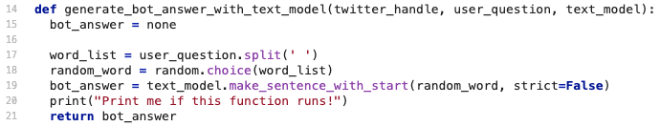
Let's investigate.
When you have bugs in your program, you can investigate by adding print() statements.
We want to make sure our generate_bot_answer_with_text_model() function is working.
Let's add a print statement on Line 20 that says "Print me if this function runs!"

Slide 51
Let's investigate.
This will print in your Glitch logs. Let's open the logs!

Slide 52
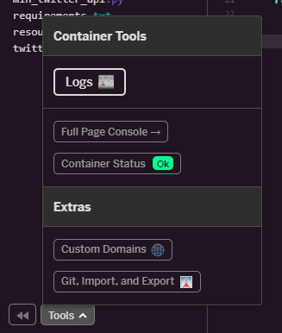

Let's investigate.
At the bottom of the page, click Tools then Logs.
When the logs open, click Clear.

Slide 53
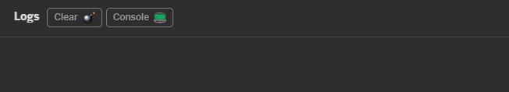
Let's Investigate!
Go back to the live app and try it again!
Then, go back to Glitch and read your logs. Did your statement print?

Slide 54
Let's Investigate!
Nothing is printing! Does anyone know why?
Notes:
(answer: we haven’t called the function from anywhere yet!)

Slide 55
Let's Investigate!
Nothing is printing! Does anyone know why?
It's because we wrote the function, but never called it! Let's fix that now.
Notes:
(answer: we haven’t called the function from anywhere yet!)

Slide 56
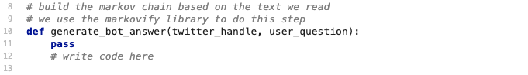
Let's write some code!
Let's go back to markov.py.
Notice that around Line 9, it says we should be using the markovify library? I don't see us using it anywhere! Let's consult the documentation.

Slide 57
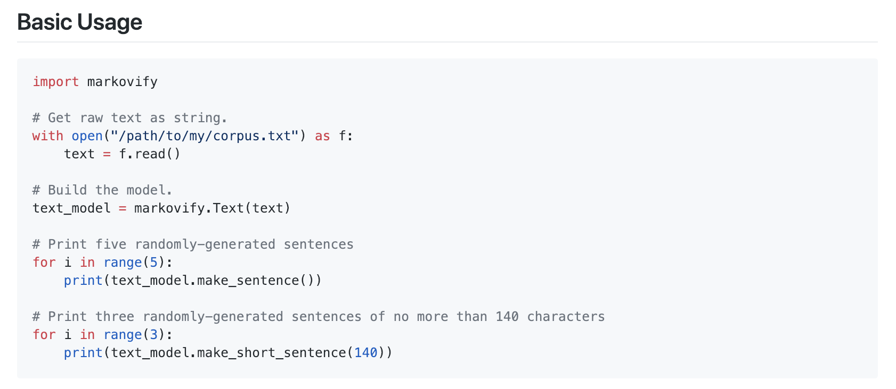
Markovify Documentation
This is the "Basic Usage" documentation from Markovify. Remember, we use Markovify to generate a Markov Chain model. Which line of code do you think is doing that? We need to add it to our code!

Slide 58
Markovify Documentation
That's the one! Let's add it to our function.

Slide 59
Let's write some code!
10
11
12
13
14
15
16
17
18
19
def generate_bot_answer(twitter_handle, user_question):
tweets = get_user_tweets(twitter_handle)
On Line 11, delete pass.
Then, use the get_user_tweets() function to save tweets to a variable called tweets.

Slide 60
Let's write some code!
10
11
12
13
14
15
16
17
18
19
def generate_bot_answer(twitter_handle, user_question):
tweets = get_user_tweets(twitter_handle)
clean_tweets = clean_tweets_data(tweets)
text = ''.join(map(str, clean_tweets))
On Line 12, use the clean_tweets_data() function to clean the Tweets. Save this to a variable called clean_tweets.
On Line 13, use the join() function to convert the clean tweets into a string. Save this to a variable called text.

Slide 61
Let's write some code!
10
11
12
13
14
15
16
17
18
19
def generate_bot_answer(twitter_handle, user_question):
tweets = get_user_tweets(twitter_handle)
clean_tweets = clean_tweets_data(tweets)
text = ''.join(map(str, clean_tweets))
text_model = markovify.Text(text)
On Line 14, use the .Text() method from the markovify library. Save the output to a variable called text_model. What should we pass to .Text()?

Slide 62
Let's write some code!
10
11
12
13
14
15
16
17
18
19
def generate_bot_answer(twitter_handle, user_question):
tweets = scrape(twitter_handle)
clean_tweets = clean_tweets_data(tweets)
text = ''.join(map(str, clean_tweets))
text_model = markovify.Text(text)
bot_answer = generate_bot_answer_with_text_model(twitter_handle, user_question, text_model)
return bot_answer
Now that we have created the text model, we need to call the function we wrote before! Call it on Line 16 in a return statement and then return bot_answer

Slide 63
Let's Try it Out!
In the top left hand corner of your browser, click Show Live
Try it in the browser tab that opens!

Slide 64
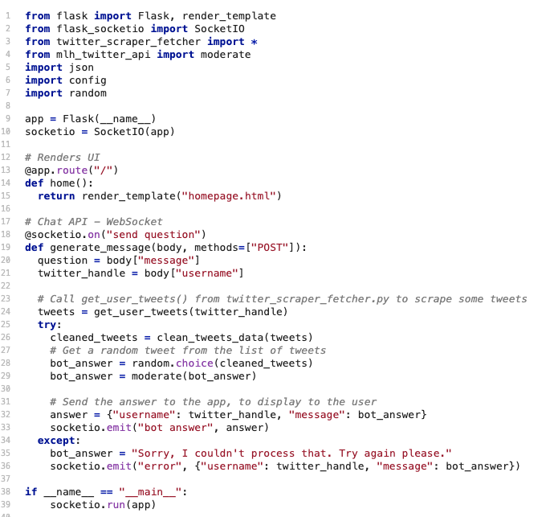
Let's Investigate!
Your statement still didn't print. That's because we also have to edit main.py!

Slide 65
Let's write some code!
Let's import markov.py into main.py so we can use our generate bot answer function! It should look like Line 8.
1
2
3
4
5
6
7
8
from flask import Flask, render_template
from flask_socketio import SocketIO
from twitter_scraper_fetcher import *
from content_moderator import moderate
import json
import config
import random
from markov import *

Slide 66
Let's write some code!
Now, scroll down to Line 25.
On line 25, call generate_bot_answer() and save it's output to a variable called bot_answer.
Add the following code to line 26:
23
24
25
26
try:
# Use our new functions to get tweets!
bot_answer = generate_bot_answer(twitter_handle, question)
moderated_answer = moderate(bot_answer)

Slide 67
We have a little more work to do!
You've got this!
Notes:
What to Say:
Read the slide.

Slide 68
Let's write some code!
Return to markov.py. Add the code below:
18
19
20
21
22
23
24
25
26
27
28
def generate_bot_answer_with_text_model(...):
bot_answer = None
word_list = user_question.split(' ')
random_word = random.choice(word_list)
bot_answer = text_model.make_sentence_with_start(random_word, strict=False)
if bot_answer == None:
bot_answer = text_model.make_sentence(test_output=False)
return bot_answer
Now it should work every time!

Slide 69
Let's try it out!
Notes:
What to Say:
Read the slide.

Slide 70
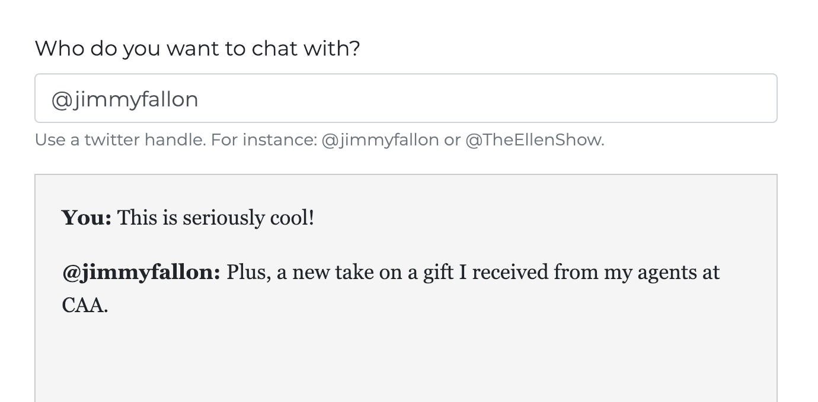
Try again!
Go back to the live app and try it again!

Slide 71
You did it!
Notes:
What to Say:
Read the slide.

Slide 72
But! We're going to add one more thing.
Notes:
What to Say:
Read the slide.

Slide 73
AI requires a huge data set!
In order for Markovify to generate really good responses, we want to use the Twitter API instead of scraping for Tweets.
Change line 33 (it might have moved) to say fetch instead of get_user_tweets.
30
31
32
33
34
35
36
37
38
def generate_bot_answer(twitter_handle, user_question):
tweets = fetch(twitter_handle)
clean_tweets = clean_tweets_data(tweets)
text = ''.join(map(str, clean_tweets))
text_model = markovify.Text(text)
return generate_bot_answer_with_text_model(twitter_handle, user_question, text_model)
Notes:
Special thanks to https://medium.com/@Alexander_H/scraping-wikipedia-with-python-8000fc9c9e6c for inspiration!

Slide 74
Now try your app again, and enjoy your AI powered Twitter conversations!
Notes:
What to Say:
Read the slide.

Slide 76
What did you learn today?
We created a fun quiz to test your knowledge and see what you learned from this workshop.
http://mlhlocal.host/quiz
Notes:
What to Say:
Read the slide.
What to Do:
Get participants excited about taking the quiz. Encourage them all to take it, and pass out stickers to participants who earn 100s. Also encourage participants to take the survey - let them know that Localhost takes their feedback very seriously and we use their feedback to make the workshop better for future participants.

Slide 78
Next Steps
Where to go from here...
Take a course on Codecademy or Udacity.
1
2
Try out Code Wars
3
Stay tuned for more opportunities from Capital One!

Slide 79
v.0.0.1

